Slide 1
Student Success Center Marketing Research Report
Kate Malazonia
Yarelis Nieves Marrero
Joe Valenzuela
Notes:
Kate
Thank Dr
ALL Introduce

Slide 2
Executive Summary
"One stop collaborative student life cycle success experience."
KPI being focused on: Registered student retention, persistence, and graduation.
Research aims to identify themes in how students want to develop in the following ways:
Professional, academic and personal development
Conducted secondary research into SSCs, social media and email
The results and recommendations of our findings are highlighted
Primary research through IDIs, focus groups, word/pic associations and surveys
Notes:
Kate
High Level Overview of what we have done

Slide 3
Problem Statement and Research Goals
"For the school to establish a resourceful Student Success Center, they must identify the services that students desire to be present at the SSC."
Effective Communication with Students:
Decrease Student Attrition
Increase Student Retention
Building a “Sense of Belonging”
Services for Disadvantaged Students
Identifying Student Expectations
Best Way to Track Progress of Students
Notes:
Yarelis

Slide 4
Research Questions
What services do students need?
What services do students perceive they need to be successful?
How can we successfully advertise the new McCoy College of Business Student Success Center at Texas State University and its offerings to the entire undergraduate community?
Notes:
Yarelis
What services do students need? - Can we really determine this? What we took away
What services do students perceive they need to be successful? - What they say
How can we successfully advertise the new McCoy College of Business Student Success Center at Texas State University and its offerings to the entire undergraduate community? - COmmunication Plan

Slide 5
Sample
IDI, focus group and Word/Pic Association participants: Principles of Marketing class
Senior sample: undergraduate marketing management class
Short answer survey: Principles of Marketing classes
Freshman sample: email sent to all freshmen McCoy students
Notes:
kate

Slide 6
Sample Cont.
Description | # of Respondents
IN-DEPTH-INTERVIEW | 8
FOCUS GROUP | 14
ONLINE SURVEY | 138

Slide 7
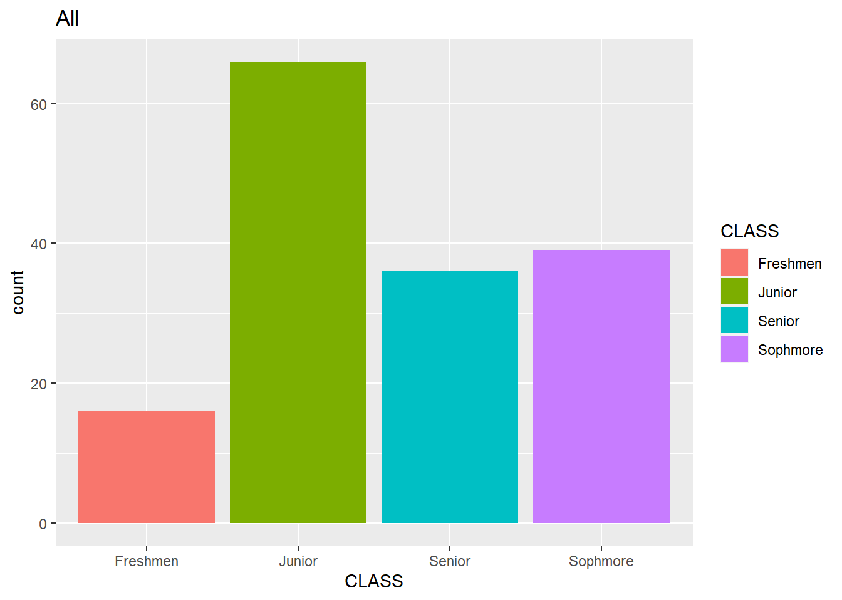
Demographics
Bias towards marketing students
Significantly more juniors responded to surveys
Ethnicity is biased towards White (Non-Hispanic)
  University trends evenly to Hispanic/White non-Hispanic
Transfer student's sophomore+
Notes:
Joe

Slide 8
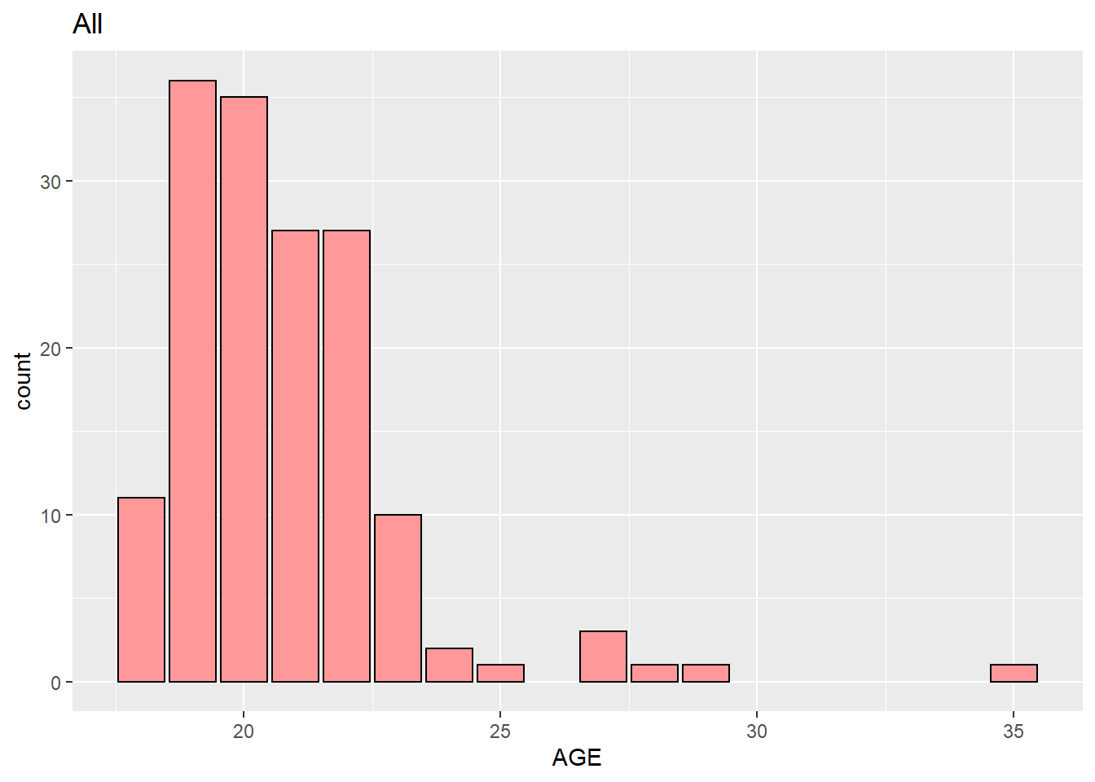
Demographics
 | Freshman | Sophomore | Junior | Senior | Total
Age
Age Range | 18 - 25 | 18 - 23 | 18 - 29 | 20 - 35 | 18 - 35
Average Age | 18.81 | 19.5 | 20.77 | 22.9 | 20.7
Gender
Female | 10 (63%) | 18 (46%) | 36 (55%) | 17 (47%) | 81 (52%)
Male | 6 (38%) | 21 (54%) | 30 (45%) | 19 (53%) | 76 (48%)
Race/Ethnicity
African-American/Black | 0 (0%) | 6 (15%) | 6 (9%) | 4 (11%) | 16 (10%)
Asian American/Pacific Islander | 0 (0%) | 3 (8%) | 2 (3%) | 0 (0%) | 5 (3%)
Hispanic/Latino | 8 (50%) | 8 (21%) | 15 (23%) | 12 (33%) | 43 (27%)
Other | 1 (6%) | 1 (3%) | 5 (8%) | 1 (3%) | 8 (5%)
Prefer not to say | 0 (0%) | 0 (0%) | 1 (2%) | 0 (0%) | 1 (1%)
White (non-Hispanic) | 7 (44%) | 21 (54%) | 37 (56%) | 19 (53%) | 84 (54%)
Transfer Student
No | 14 (88%) | 30 (77%) | 31 (47%) | 21 (58%) | 96 (61%)
Yes | 2 (13%) | 9 (23%) | 35 (53%) | 15 (42%) | 61 (39%)
Semesters completed
1 - 2 semesters | 0 (0%) | 21 (54%) | 14 (21%) | 2 (6%) | 37 (24%)
3 - 4 semesters | 0 (0%) | 13 (33%) | 18 (27%) | 5 (14%) | 36 (23%)
5 - 6 semesters | 0 (0%) | 0 (0%) | 7 (11%) | 10 (28%) | 17 (11%)
7 - 8 semesters | 0 (0%) | 0 (0%) | 2 (3%) | 13 (36%) | 15 (10%)
More than 8 semesters | 0 (0%) | 0 (0%) | 0 (0%) | 5 (14%) | 5 (3%)
None - this is my first semester | 16 (100%) | 5 (13%) | 25 (38%) | 1 (3%) | 47 (30%)

Slide 9
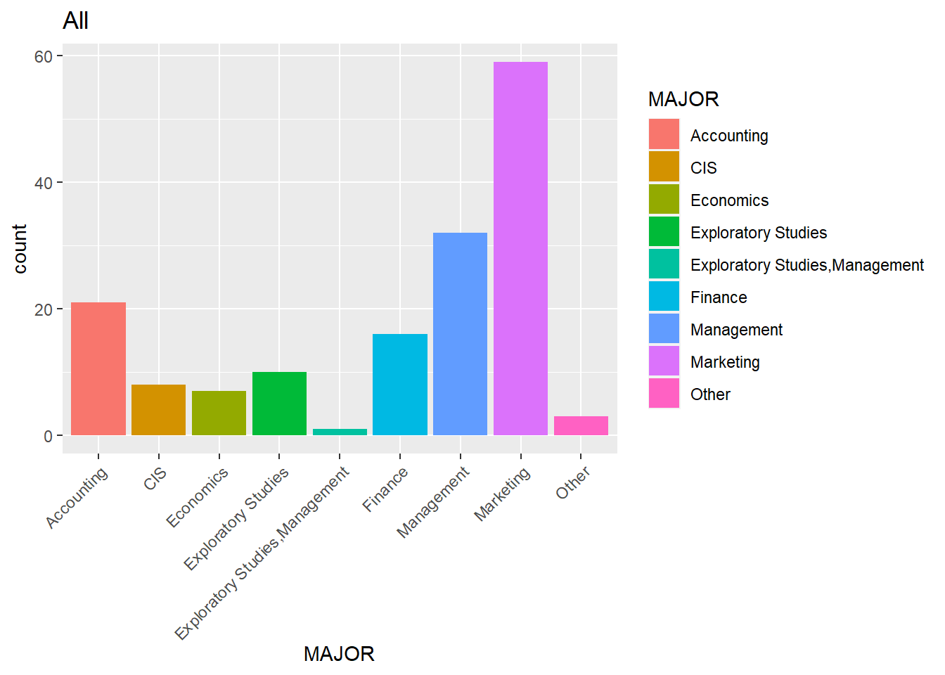
Demographics
 | Freshman | Sophomore | Junior | Senior | Total
What is your major?​ | ​ | ​ | ​ | ​ | ​
Accounting​ | 1 (6%)​ | 6 (15%)​ | 12 (18%)​ | 2 (6%)​ | 21 (13%)​
CIS​ | 2 (13%)​ | 1 (3%)​ | 3 (5%)​ | 2 (6%)​ | 8 (5%)​
Economics​ | 1 (6%)​ | 1 (3%)​ | 5 (8%)​ | 0 (0%)​ | 7 (4%)​
Exploratory Studies​ | 0 (0%)​ | 6 (15%)​ | 4 (6%)​ | 1 (3%)​ | 11 (7%)​
Finance​ | 2 (13%)​ | 4 (10%)​ | 9 (14%)​ | 1 (3%)​ | 16 (10%)​
Management​ | 5 (31%)​ | 7 (18%)​ | 18 (27%)​ | 2 (6%)​ | 32 (20%)​
Marketing​ | 5 (31%)​ | 14 (36%)​ | 12 (18%)​ | 28 (78%)​ | 59 (38%)​
Other​ | 0 (0%)​ | 0 (0%)​ | 3 (5%)​ | 0 (0%)​ | 3 (2%)​
Do you live in San Marcos​ | ​ | ​ | ​ | ​ | ​
No, What city | 2 (13%)​ | 3 (8%)​ | 9 (14%)​ | 7 (19%)​ | 21 (13%)​
Yes​ | 14 (88%)​ | 36 (92%)​ | 57 (86%)​ | 29 (81%)​ | 136 (87%)​
First Generation Student​ | ​ | ​ | ​ | ​ | ​
No​ | 13 (81%)​ | 28 (72%)​ | 46 (70%)​ | 24 (67%)​ | 111 (71%)​
Yes​ | 3 (19%)​ | 11 (28%)​ | 20 (30%)​ | 12 (33%)​ | 46 (29%)​
Member of a Student Org.​ | ​ | ​ | ​ | ​ | ​
No​ | 10 (67%)​ | 15 (45%)​ | 39 (70%)​ | 15 (44%)​ | 79 (57%)​
Yes​ | 5 (33%)​ | 18 (55%)​ | 17 (30%)​ | 19 (56%)​ | 59 (43%)​
Registered with ODS​ | ​ | ​ | ​ | ​ | ​
No​ | 13(81%)​ | 33(85%)​ | 63(95%)​ | 35(97%)​ | 144(92%)​
Yes​ | 3(19%)​ | 6(15%)​ | 3(5%)​ | 1(3%)​ | 13(8%)​
Veteran​ | ​ | ​ | ​ | ​ | ​
No​ | 15 (94%)​ | 39 (100%)​ | 65 (98%)​ | 34 (94%)​ | 153 (97%)​
Yes​ | 1 (6%)​ | (0%)​ | 1 (2%)​ | 2 (6%)​ | 4 (3%)​

Slide 10
Process
Primary research and secondary research conducted
In-Depth interviews (IDIs)
Focus Groups
Online Surveys
All interviews and surveys had a predetermined set of questions
Moderators used follow up questions/further probing
Online surveys conducted through email
Responses tracked through an excel spreadsheet
Email Traffic Analysis
Word/Picture Association
Website Recommendations
Notes:
Kate
o gain deeper understanding of student perceptions

Slide 11
Process for Coding IDI's/ Focus Groups
Coded using a systematic approach
Completed by 3 researchers with a review system for each sets of codes
Coding system: overall code, a theme and a category
Notes:
Kate

Slide 12
Coding Plan Example
Question | Codes | Groups
Please tell us about a positive experience being a student in Texas State | Services | Service Usage
 | Classes | Academic Success/Career Preparedness
 | Financial | Reward
 | staff | Academic Success/Career Preparedness
 | community | Community
Please tell us about a negative experience being a student at Texas State | Facilities | Pain Points
 | Academics | Academic Success
 | Time Management | Academic Success
 | Staff | Academic Success
 | Inconsistent Professors | Academic Success
What are your biggest challenges being a student at Texas State? What causes you stress? | Exams/Academics | Pain Points
 | Anxiety Reduced through Knowledge | Academic Success
How is McCoy College preparing you for success after college? | Instructor Real World Knowledge | Career Preparedness
 | Career Exploration | Career Preparedness
 | Organizations | Community
 | Unhelpful Professors | Pain Points
What do you or other business students need from Texas State or McCoy College to be successful? | Resource Availability | Pain Points
 | Resource Information | Outreach
 | Skills Workshops | Career Preparedness
full plan in appendix.
Notes:
Joe

Slide 13

Word Association Results
Community
Success
Stress
Guidance
Resources
Communication
Events
Mentor
Notes:
Yarelis

Slide 14
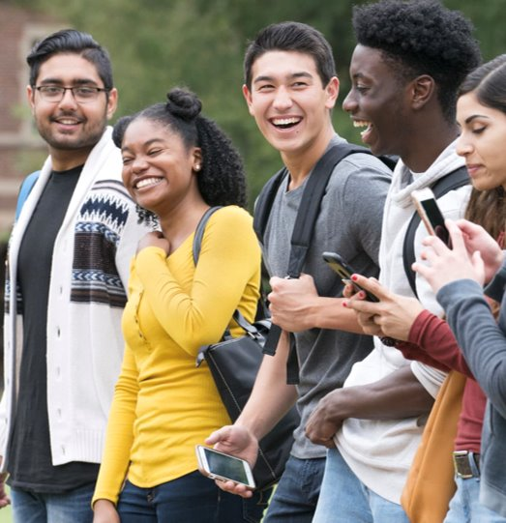




Picture Association Results
Community
Stress
Guidance
Mentor
Success
Notes:
Yarelis

Slide 15
Themes Identified Word/Picture Association
Social Interaction
Academic Support
Financial Support
Personal Relationships
Hybrid Communication
Social and Extra-curricular events
Faculty/ Staff Relationships
Notes:
Yarelis

Slide 16
Secondary Research Findings
Focus on First-Year Students
Student-Faculty Contact Time
Quality of Information Provided to Parents
Student Centered Culture
Quality of Support Services
A Sense of Community
Social Media – The New Email?
Notes:
Kate

Slide 17
Research Question: What Services do Students Need?
Questions asked during the interview:
Q3:What are your biggest challenges being a student at Texas State? What causes you stress?
Q7: What workshops are you interested in? career, professional development, mental health – back to student success center
Q8: Why do you think people use or don’t use career services, counseling center, writing center, SLAC, academic advising, professional development events, etc.?
Q11: Do you feel like a part of the McCoy College? Why or why not?
Recurring themes:
Academic Overload
Lack of understanding of how to navigate the degree program
Anxiety about career prospects and life choices
Lack of awareness of resources till too late
Social Interaction with other students is important
Notes:
Yarelis

Slide 18
Standout Quotes for Research Q 1
What services do students need?
"I work as an RA...so living where I work and navigating that as a student is difficult"
"My advisor kind of screwed me over a little bit freshman year, so I'm not really a big fan of using their services. I lost a scholarship because of them."
"Being a peer mentor, my whole job is to advocate for those specific resources like tutoring... and I know a ton of people don't use them because I feel like they just don't know where to start."
"Something that I think would help me and other business students at Texas State would be something like weekly opportunities to get to know other business students and talk to professors or other business-minded professionals to gain more tips about my specific career path, whether that be through meetings in McCoy or just some type of social gathering on campus."
Notes:
Yarelis

Slide 19
Recommendations
Social Interaction: Have mixers or something in between social/professional
Mentoring for Students by Students
Tutoring: For Gen-eds/entry requirements
Tutoring Specific to McCoy Classes
Notes:
Yarelis

Slide 20
Research Question 2: What services do students perceive they need to be successful?
Questions asked during the interview:
Q5: What do you or other business students need from Texas State or McCoy College to be successful?
Q7: What workshops are you interested in? career, professional development, mental health – back to student success center
Q13: Do you have a mentor or a person who guides you, either on campus or associated with the university?
Recurring themes:
Questioning what opportunities are available to them
Q4: How is McCoy College preparing you for success after college?
Q6: Many universities and colleges across the U.S. are adding student success centers. What do you think a McCoy student success center should be and what services should it offer?
Students feel that success equates to achieving a good job after college (Feeling intensifies as they near graduation)
Students engaged outside McCoy feel less engaged with the college
Hard Skills/Resume Flair are things McCoy Students feel like they are missing
Notes:
Yarelis

Slide 21
Standout Quotes for Research Q 2
What services do students perceive they need to be successful?
"I need job opportunities and the ability to do internships starting freshman year. It would be wonderful if y'all had well known company's guarantee employment for those who completed select programs like SMIF. It would be great if if y'all had a banking club or organization that could guarantee employment in the field."
"Introducing me to a lot of people that I could end up working with in the future...really giving me opportunities to meet recruiters and join organizations that could help me network, or just be a part of something bigger."
"All the business professors have some sort of experience in the business world and they always integrate that into their content."
"I have access to all the accounting resources and everything. I get like weekly newsletters and stuff from them. I'm also a finance major, but I don't think I've heard anything from them. It's just kind of like sink or swim."
Notes:
Yarelis

Slide 22
Recommendations
Hard Skills – Certificates ex: PDU's lead to Certified Associate Project Manager (CAPM) Certificate
Internship postings kiosk
Specific Tutoring to McCoy
Weekly Advisor Check-in Meetings at the MSSC for Freshmen/Transfers
Mentoring from Business Professionals
Notes:
Yarelis

Slide 23
Research Question 3: How can we successfully advertise the new McCoy College of Business Student Success Center at Texas State University and its offerings to the entire undergraduate community?
Questions asked during the interview:
Q10: Where do you get most of your information regarding university and McCoy College services, events, and activities? How do you preferred to receive this information?
Q12: What are ways in which McCoy College can build a sense of community for its students?
Recurring themes:
Students show up to events they can receive a reward, or they feel are directly relevant to their career/degree
Q9: What would motivate you to attend a McCoy event or utilize McCoy services?
Email is the primary information method, but information gets lost in the noise
Communication plan is different for different events with multiple sources of information depending on what is going on
Social Events are things which students overwhelmingly want
Notes:
Yarelis

Slide 24
Standout Quotes for Research Q 3
How can we successfully advertise the new McCoy College of Business Student Success Center at Texas State University and its offerings to the entire undergraduate community? ​
"I get the emails, but I typically don't really process them. It's usually professors talking about things in class."
"I also get the emails and I read them and I'm like 'yeah I'm gonna do that'. Then, I forget to do it in the end, but my professor is the reason I used career services this semester."
"It also helps when the professor says something because we get so many emails. Me personally, I probably get about like 35, 50 accounting emails a day. It's crazy."
"Food and also recruiting opportunities"
"I know a lot of like organizations that have social media, and that's how I usually find things."
Notes:
Joe

Slide 25
Recommendations
Primary: Email – One Central Email from McCoy
Free McCoy Gear, Free Food, Extra Credit/PDUS
Centralized Communication Plan Enacted Consistently
Events Should Include Networking
Notes:
Joe

Slide 26

Other
Mental Health Counselling – Walk in Counselor at the MSSC
"It's hard for them to for some students to admit that they need assistance with that sort of thing."
"If that's going to be advertised, it needs to be significantly different than the way it's done right now because every person I know who's tried to use that has been told no, because there's no appointments left, or it just doesn't seem to work right now."
Registering for Classes – Mentoring (sample degree paths)
"More description about each professor in the classes and how they're structured would be nice."
Notes:
Kate

Slide 27
Good Ideas from Respondents
Leisure Hub at the McCoy Building
"Leisure spots where it's easier to, communicate with other McCoy students would be a good start 'cause right now we just have those chairs that all face like towards the hallway. So, they having communal spaces where people can like study and talk outside. Like Alkek, I think that would be a good thing.
"We could have something like the 7th floor of Alkek where it's just a ton of study space for you and you can interact with people at McCoy, I think that would really help."
"Since Texas State is a big commuter campus a lot of the students can't really like go back home between classes if they have an hour and a half break, so it's important to have spaces for students to chill out and have a place to be."
Workshops – Less Goldman-Sachs More Google
"Workshops for students with anxiety when they go into interviews."
"Fun workshops"

Slide 28
Good Ideas from Respondents Cont.
Run McCoy as a Business with Departments Providing "Services" to Other Colleges
"I also think that collaborating with other departments on campus would be helpful to create more well-rounded job applicants."

Slide 29

Questions?

Slide 30
Appendix

Slide 31
 | Question | Codes | Groups
1 | Please tell us about a positive experience being a student in Texas State | Services | Service Usage
 |  | Classes | Academic Success/Career Preparedness
 |  | Financial | Reward
 |  | staff | Academic Success/Career Preparedness
 |  | community | Community
2 | Please tell us about a negative experience being a student at Texas State | Facilities | Pain Points
 |  | Academics | Academic Success
 |  | Time Management | Academic Success
 |  | Staff | Academic Success
 |  | Inconsistent Professors | Academic Success
3 | What are your biggest challenges being a student at Texas State? What causes you stress? | Exams/Academics | Pain Points
 |  | Anxiety Reduced through Knowledge | Academic Success
4 | How is McCoy College preparing you for success after college? | Instructor Real World Knowledge | Career Preparedness
 |  | Career Exploration | Career Preparedness
 |  | Organizations | Community
 |  | Unhelpful Professors | Pain Points
5 | What do you or other business students need from Texas State or McCoy College to be successful? | Resource Availability | Pain Points
 |  | Resource Information | Outreach
 |  | Skills Workshops | Career Preparedness
6 | Many universities and colleges across the U.S. are adding student success centers. What do you think a McCoy student success center should be and what services should it offer? | Resource Hub | Outreach
 |  | Career Focused | Career Preparedness
7 | What workshops are you interested in? career, professional development, mental health – back to student success center | Life Skills | Academic Success
 |  | Career Soft Skills | Career Preparedness
 |  | Career Hard Skills | Career Preparedness
8 | Why do you think people use or don’t use career services, counselling center, writing center, SLAC, academic advising, professional development events, etc.? | Inconvenient | Service Usage
 |  | awareness | Outreach
 |  | inconsistent services | Service Usage
 |  | Perception | Service Usage

Slide 32
9 | What would motivate you to attend a McCoy event or utilize McCoy services? | Extra credit | Reward
 |  | food/freebies | Reward
 |  | convenience | Service Usage
 |  | relevance | Career Preparedness
 |  | Community | Community
 |  | awareness | Outreach
10 | Where do you get most of your information regarding university and McCoy College services, events, and activities? How do you preferred to receive this information? | Regular Email | Outreach
 |  | professors | Outreach
 |  | TXST app | Outreach
 |  | social media | Outreach
 |  | flyers | Outreach
 |  | location | Outreach
11 | Do you feel like a part of the McCoy College? Why or why not? | Friends | Community
 |  | organizations | Community
 |  | affiliated | Community
 |  | TIme in Building | ??
 |  | Yes | ??
 |  | No | ??

Slide 33
12 | What are ways in which McCoy College can build a sense of community for its students? | Hub for meeting | Outreach
 |  | events | Outreach
 |  | organizations | Community
13 | Do you have a mentor or a person who guides you, um, either on campus or associated with the university and maybe kind of describe that person's role, um, in your life? * (additional question) | Professor | Academic Success/Career Preparedness
 |  | family | Academic Success/Career Preparedness
 |  | staff | Academic Success/Career Preparedness
 |  | faculty | Academic Success/Career Preparedness
 |  | upper class men | Academic Success/Career Preparedness
 |  | None | Academic Success/Career Preparedness
14 | After our discussion today, is there anything else you think a McCoy student success center should include? | Convenience | Service Usage
 |  | guidance | Academic Success
 |  | Q&A with professionals | Career Preparedness
 |  | resume services | Career Preparedness

Slide 34
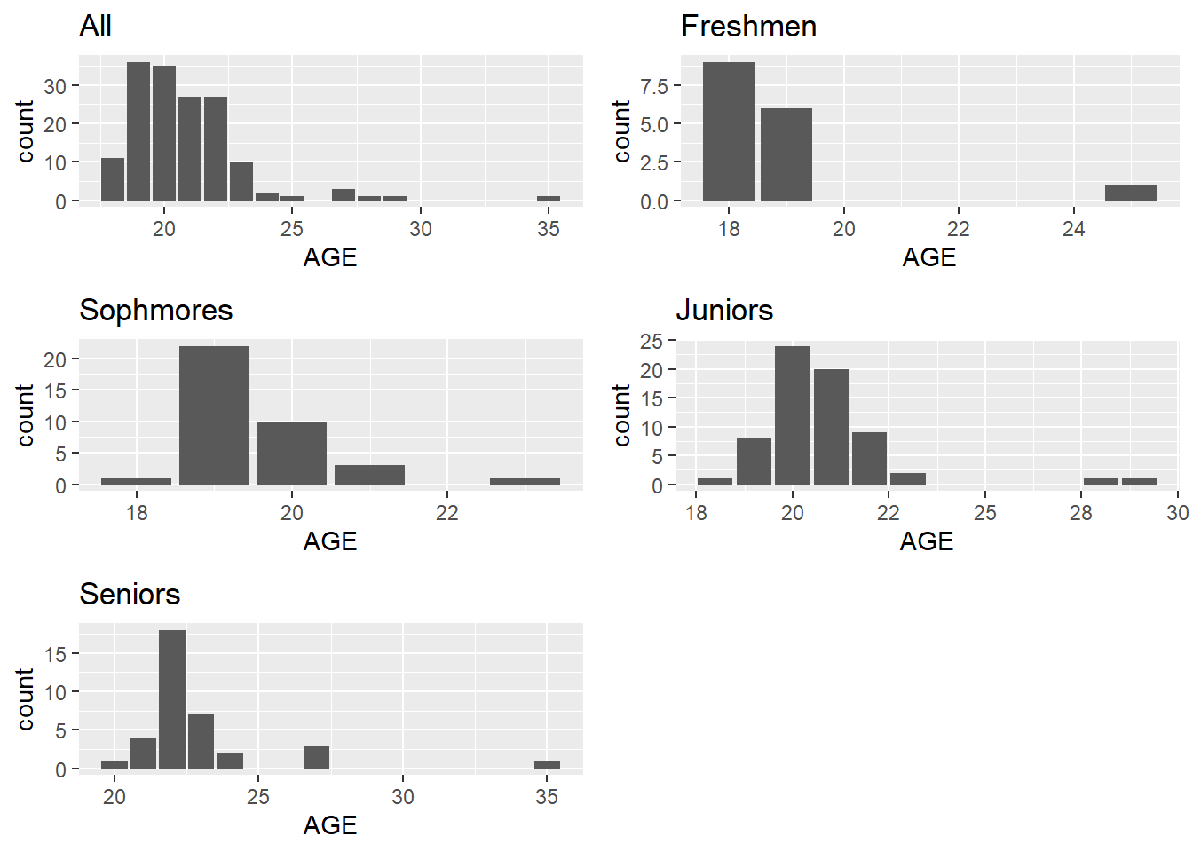
Demographics AGE
Generally normal distributions that we would expect with some outliers

Slide 35
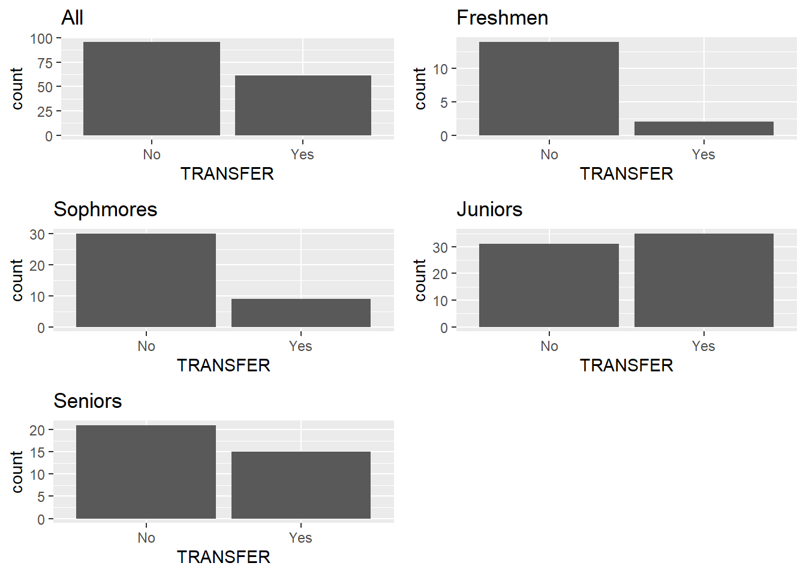
Demographics Transfers
Juniors and seniors see an increased number of transfer students (as expected)

Slide 36
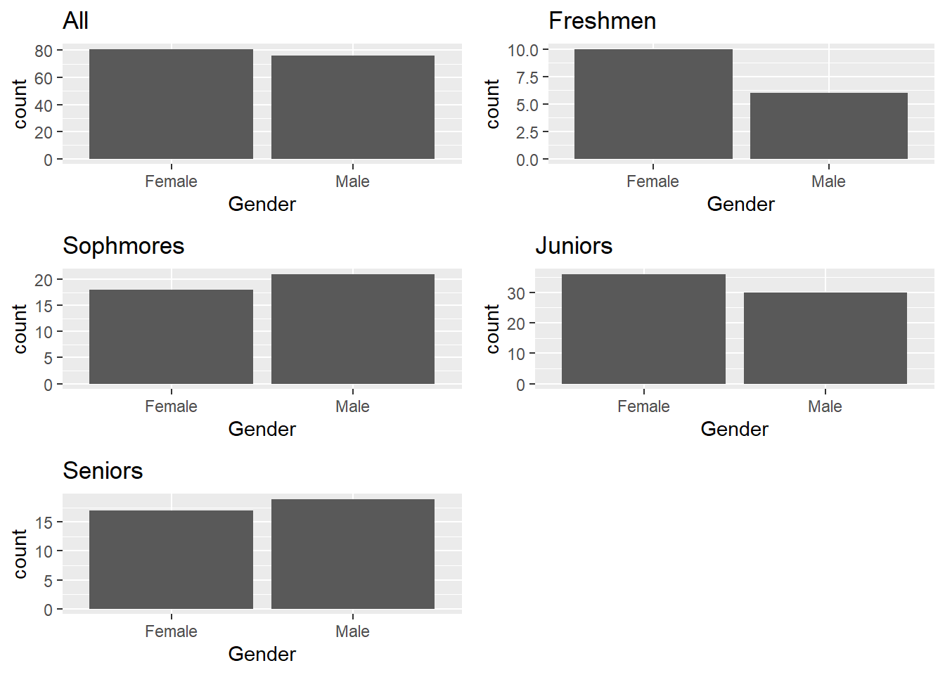
Demographics Gender
Biggest thing to note is that across the school males outnumber females

Slide 37
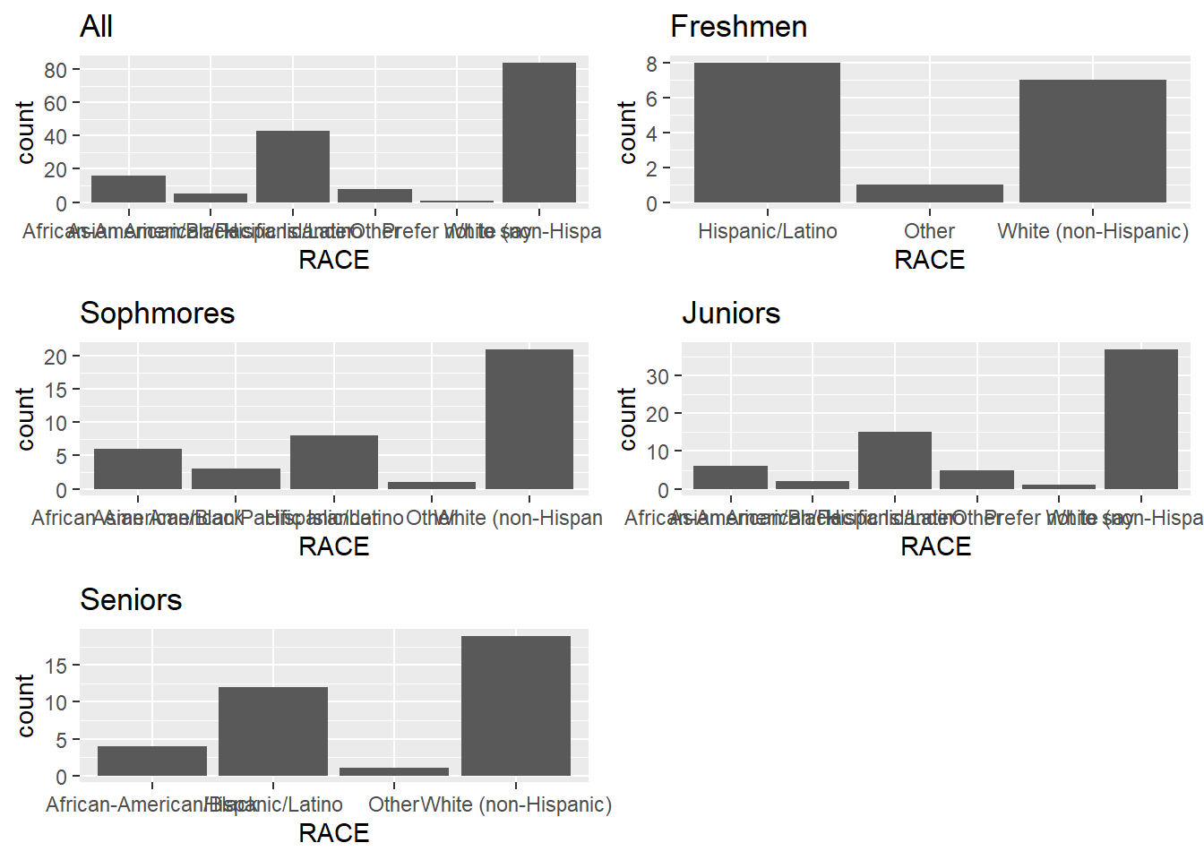
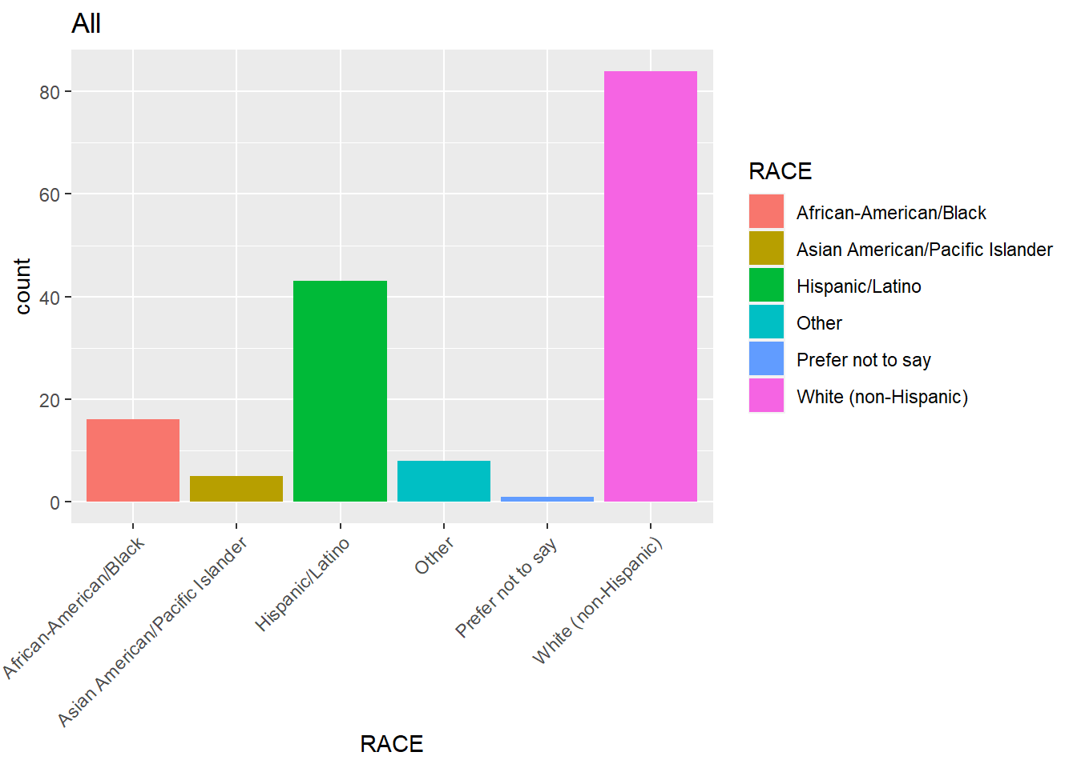
Demographics Race

Slide 38
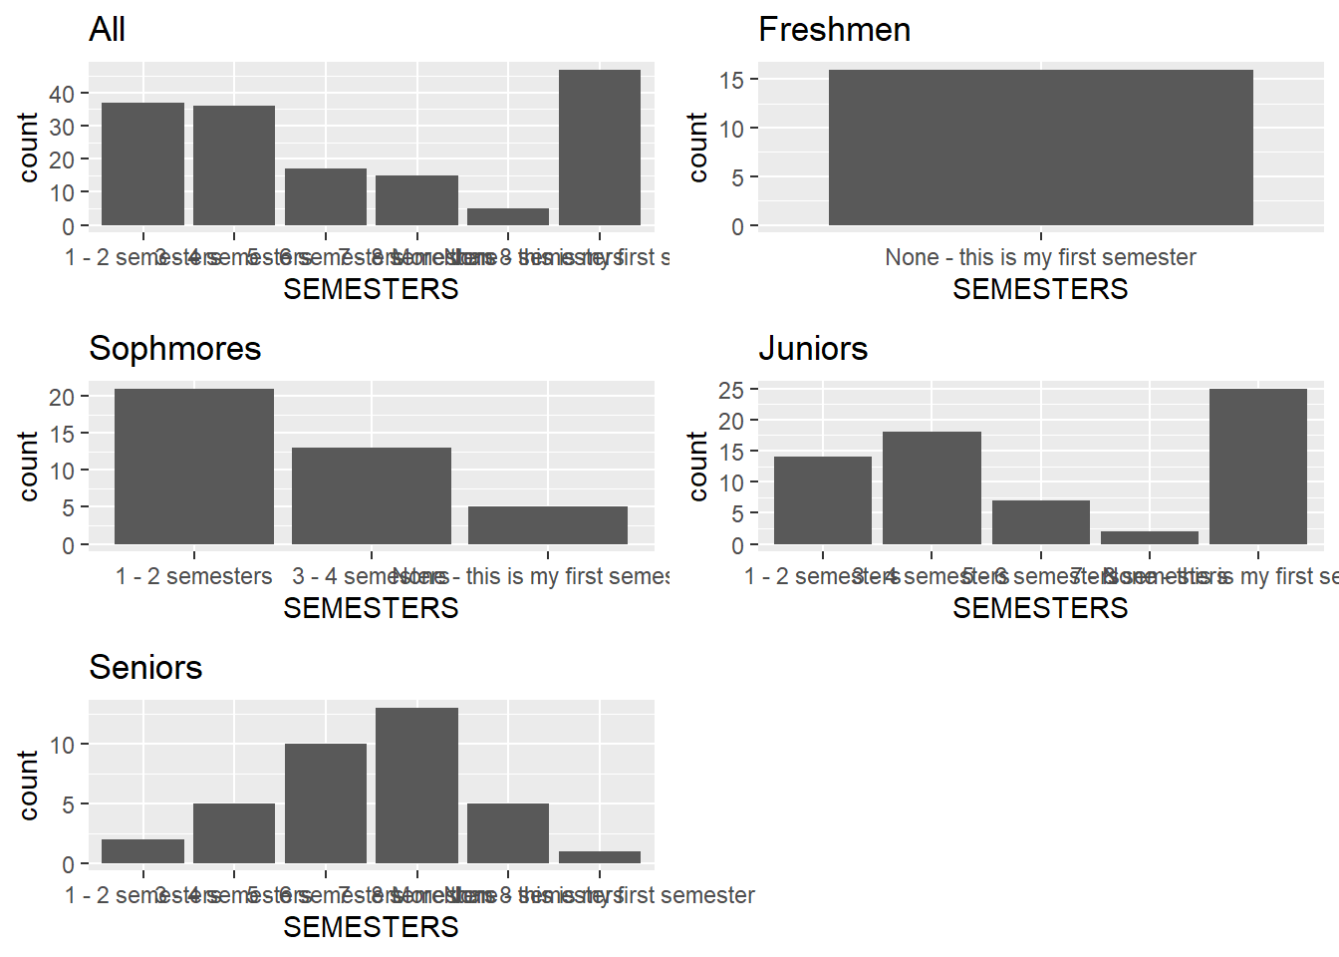
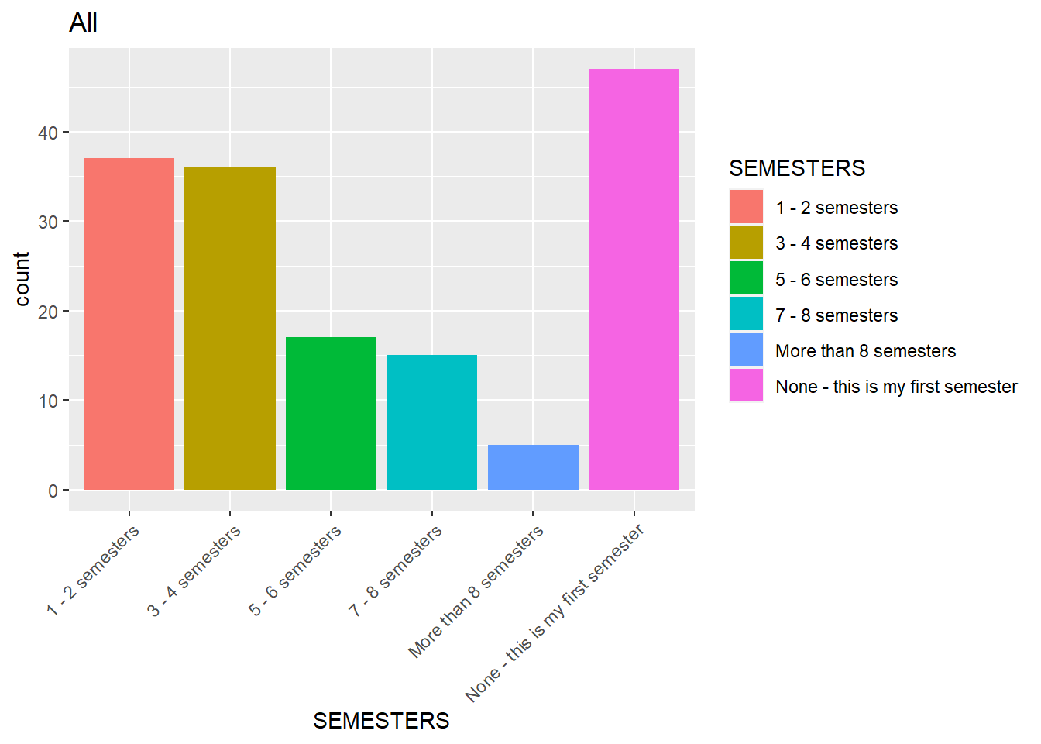
Demographics Semesters

Slide 39
Demographics Major

Slide 40
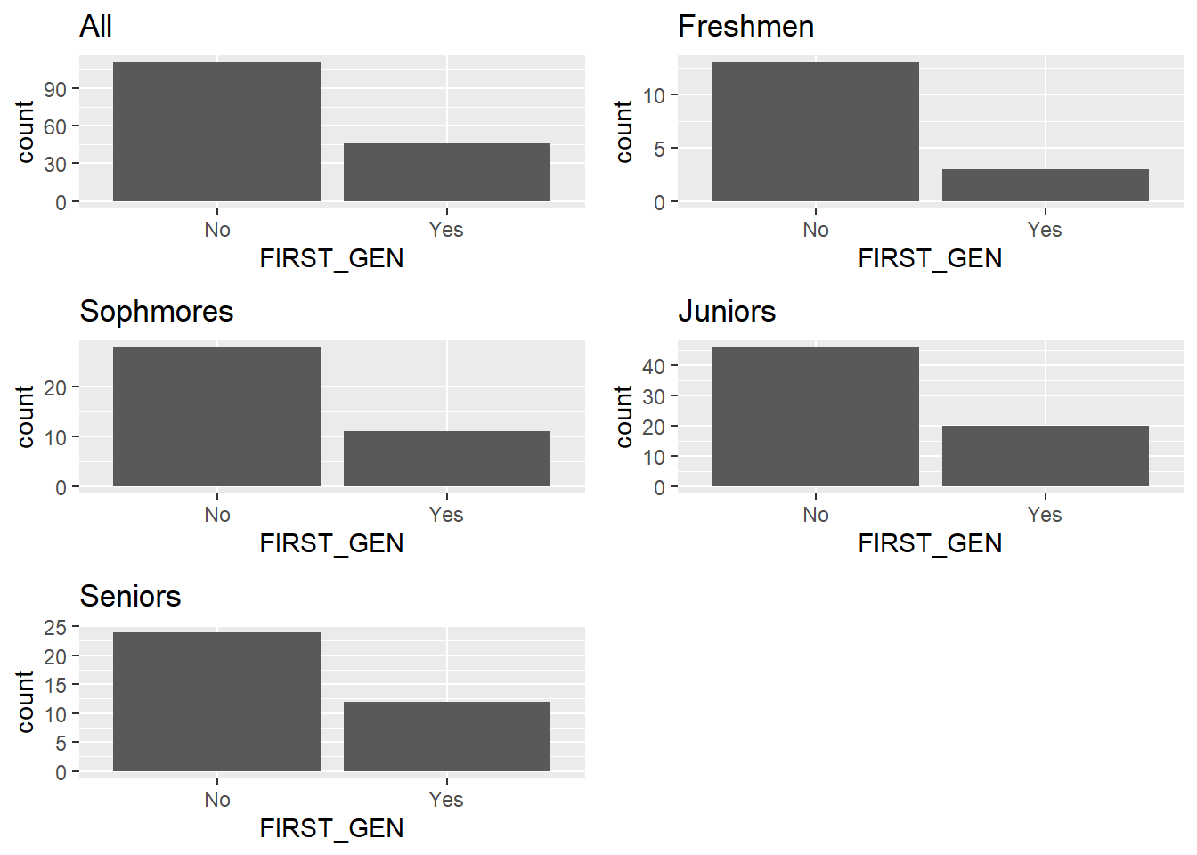
Demographics First Gen

Slide 41
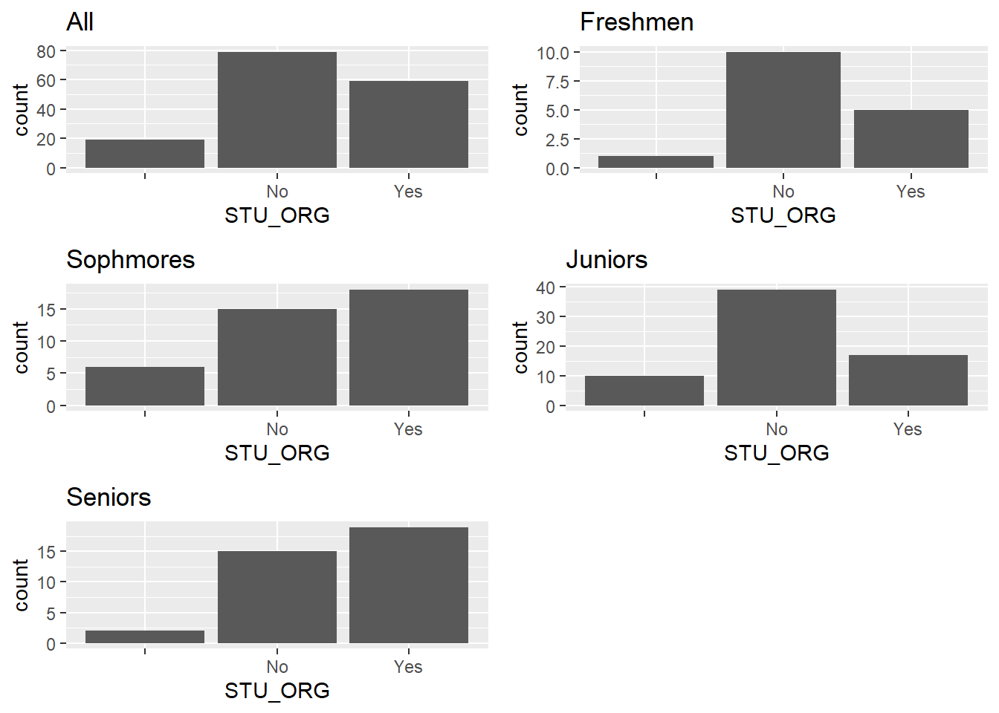
Demographics Student Organization

Slide 42
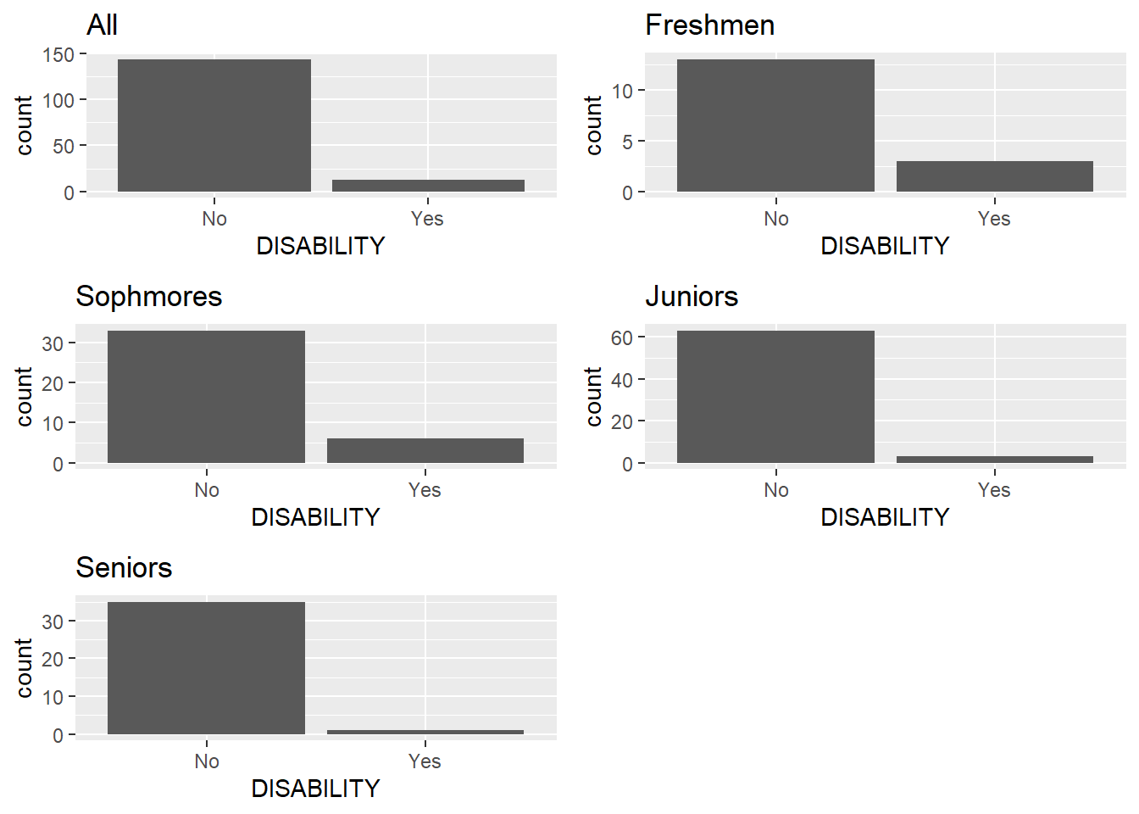
Demographics Disability

Slide 43
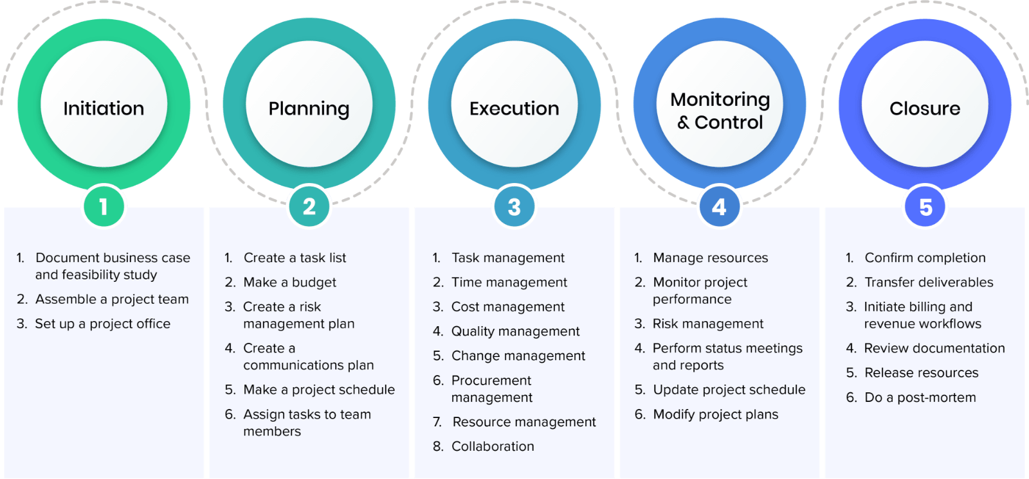
Recommendation Example Hard Skill Program
Certified Associate Project Manager (CAPM)
Purpose: Engage students in additional program that over the course of 8 semesters doing 3 hours of Project Management Education each results in ability to sit for the test and achieve a certificate.
Requirements - "23 hours of project management education completed by the time you sit for the exam."
Exam: 150 Questions
Non-member:$300.00
*if a doner sponsors this program possibly the fees could be covered
*coordination with PMI to ensure classes are valid
*staff/volunteer PMPs can get their PDU's from teaching (networking opportunity)

Slide 44

Recommendation Internship Easy Apply
Purpose: Make searching for and applying for internships easy.
Requirements: Kiosk in the MSSC
Description: Beyond just having a board with internship postings. Provide a kiosk where students can swipe their ID to log in, search through internship postings, and click apply. All relevant data would be pulled from their student database (may need a place for them to post resume).
Result: No excuses for not knowing about internship opportunities

Slide 45
Recommendation Weekly Check-In
Purpose: Ensure that students in their first semester are checking in with the advising team on a regular basis and aren't missing requirements
Requirements: Staff availability
Description: A theme that came up was students not knowing about services when they needed them or being lost about what to do. Setting a mandatory touch point at the MSSC not only centralizes information and reinforces their relationship to McCoy, but it will also help head off any issues before it ends poorly.
Result: Increased Retention of first semester students in the program
*Austin and San Antonio have many professionals that would probably be willing to take an early lunch once a quarter

Slide 46

Recommendation Business Mentorship
Issue: Students desire more interaction with current business professionals. They want to know about options career paths, life questions for people that lived it.
Purpose: Ensure that students can engage with working professionals in a mentor/mentee relationship
Requirements: business partnership
Description: This could look like 1 professional who comes to the MSSC once a quarter to talk to their mentees/get food and as needed a more one on one relationship could (lunch and learns)

Slide 47
Recommendation McCoy Tutoring Program
Purpose: Provide tutoring specific to McCoy classes, provided by other McCoy students.
Requirements: student tutors
"I think more tutoring recourses and opportunities to get help in specific business courses. I know for me personally, I learn best when it is repeated to me a bunch, and I get multiple perspectives on the topic at hand. I think for entry level business courses as well because that is the foundation you have to build on as you get your degree, and if there is something you don't understand or need more explanation, I feel like it would be beneficial to have resources at hand to help or at least to be knowledgeable about them." - Survey Response

Slide 48

Recommendation McCoy Communication plan
Issue: Currently the communications for events are different depending on who is running the event/what the event is.
Recommend centralizing the communication plan from the MSSC and following the communication methods below
P: Email One central email from McCoy
A: Social Media (Instagram) - QR Code to follow
C: Website landing MSSC HUB
E: Physical Advertisement at the MSSC
"I want more merch. I would like a cool like McCoy College of Business shirt and we don't have those and it makes me sad." - Jane Doe

Slide 49
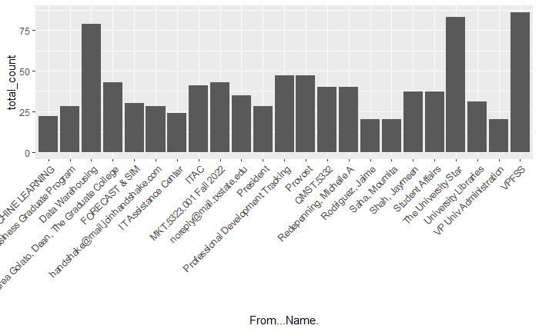
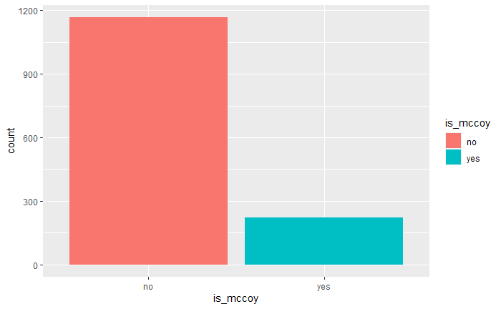
Email Traffic Analysis
Students Say that email is the primary form of communication
McCoy is competing for attention from all programs 16% of all emails received (generous estimate)
Highlighted traffic is the messages from emails that generally are about McCoy Business
Recommendation to Consolidate all McCoy Communications from one From Address with similar header: Bulletin, PDUs, Events etc.

Slide 50
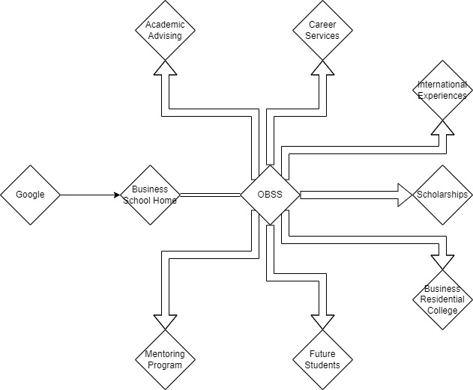
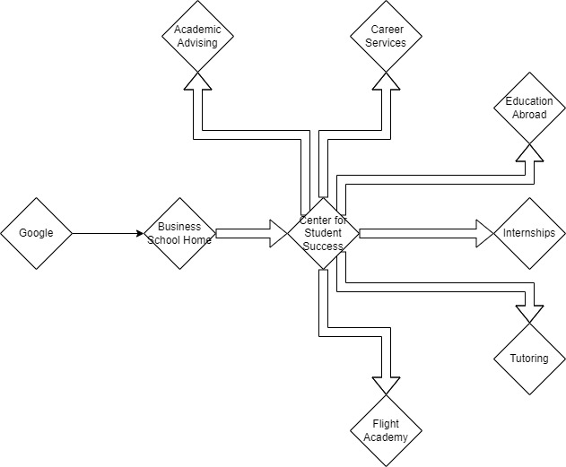
Recommendation of Website Setup
LSU
Kennesaw State
Both sites use the Student Success Center as a hub for information students are interested in. LSU's looks better, but Kennesaw State makes theirs easier to find

Slide 51
Physical Advertisement
TV displaying information/calendar of events
Merch Store for McCoy Merchandise
Free Donut Wednesday
"I want more merch. I would like a cool like McCoy College of Business shirt and we don't have those, and it makes me sad." - Jane Doe

Slide 52
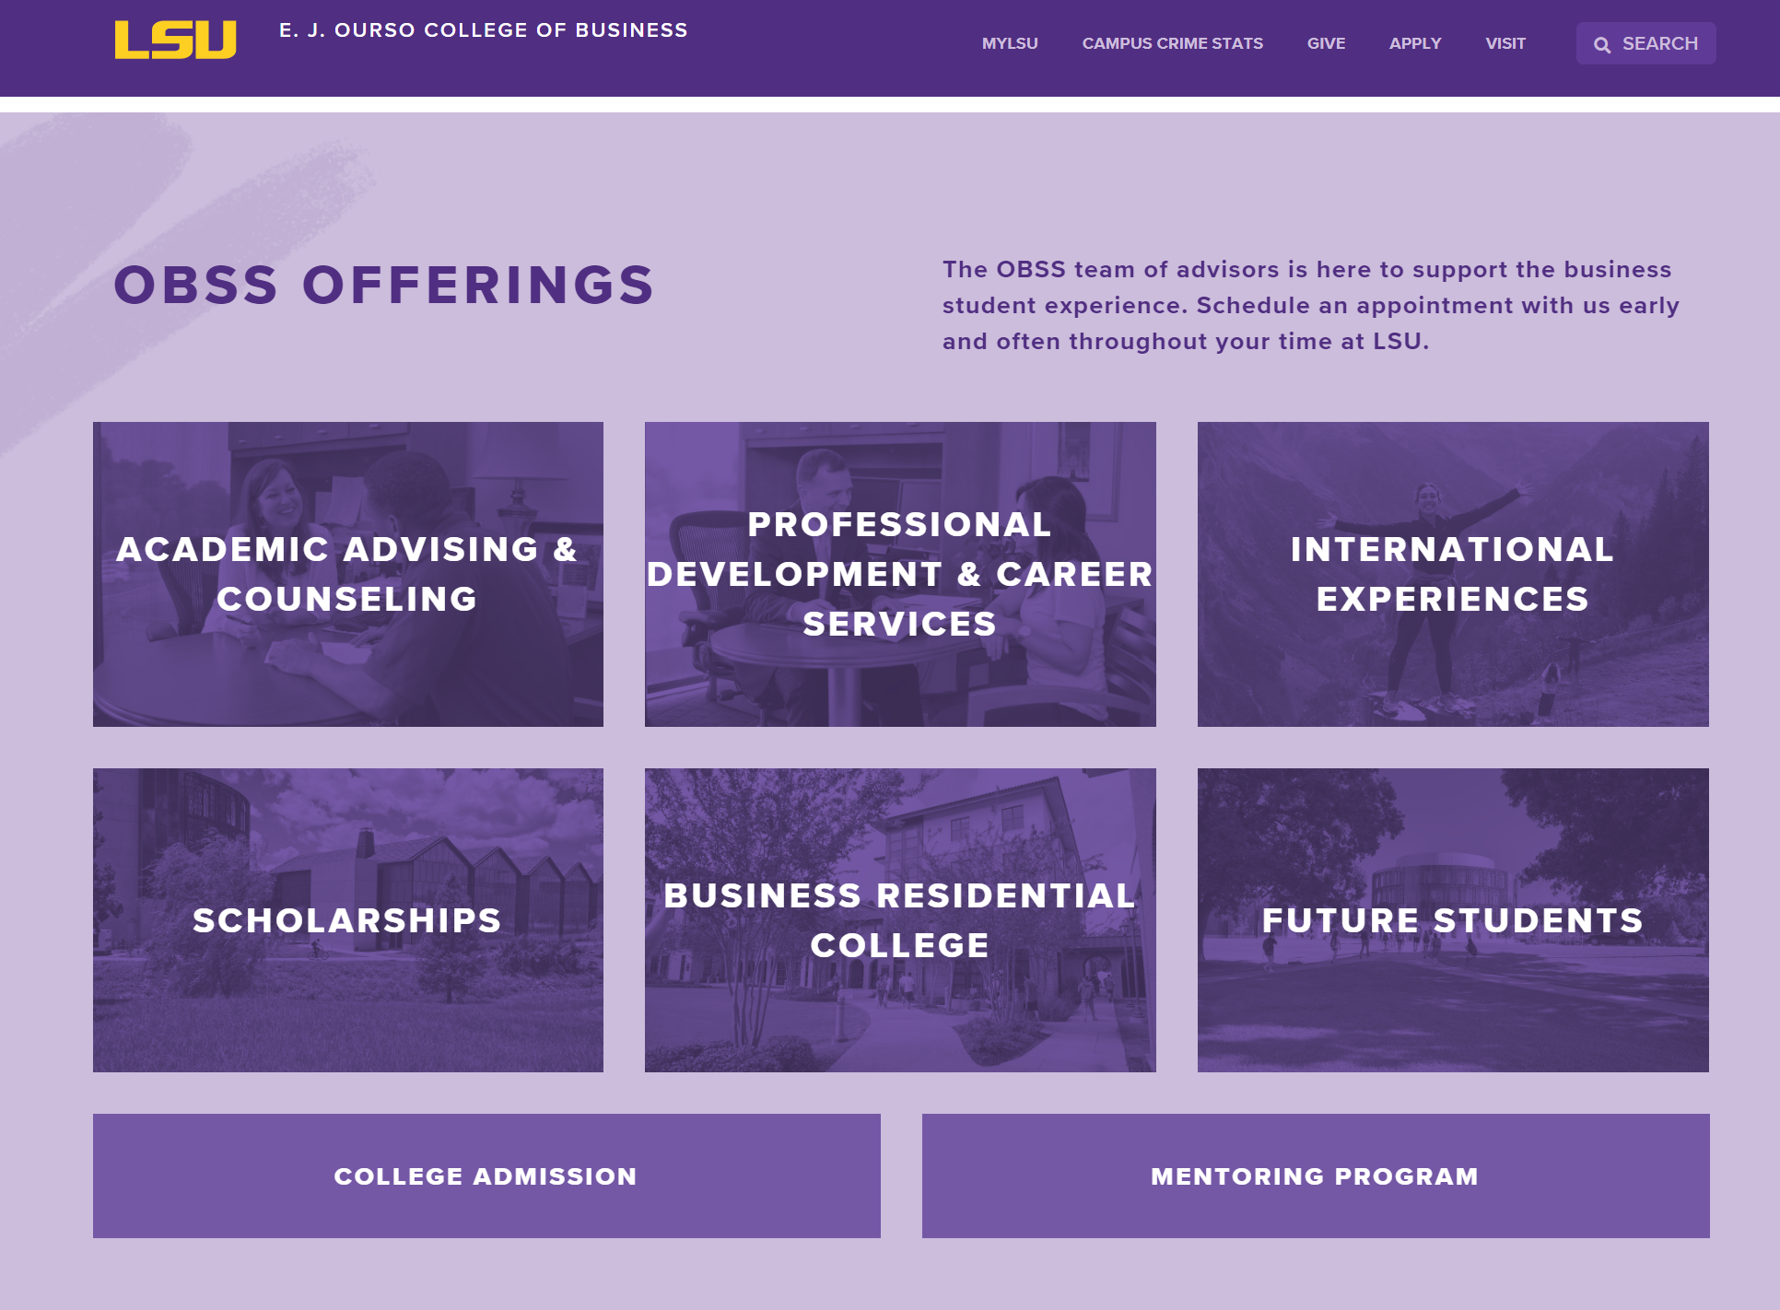
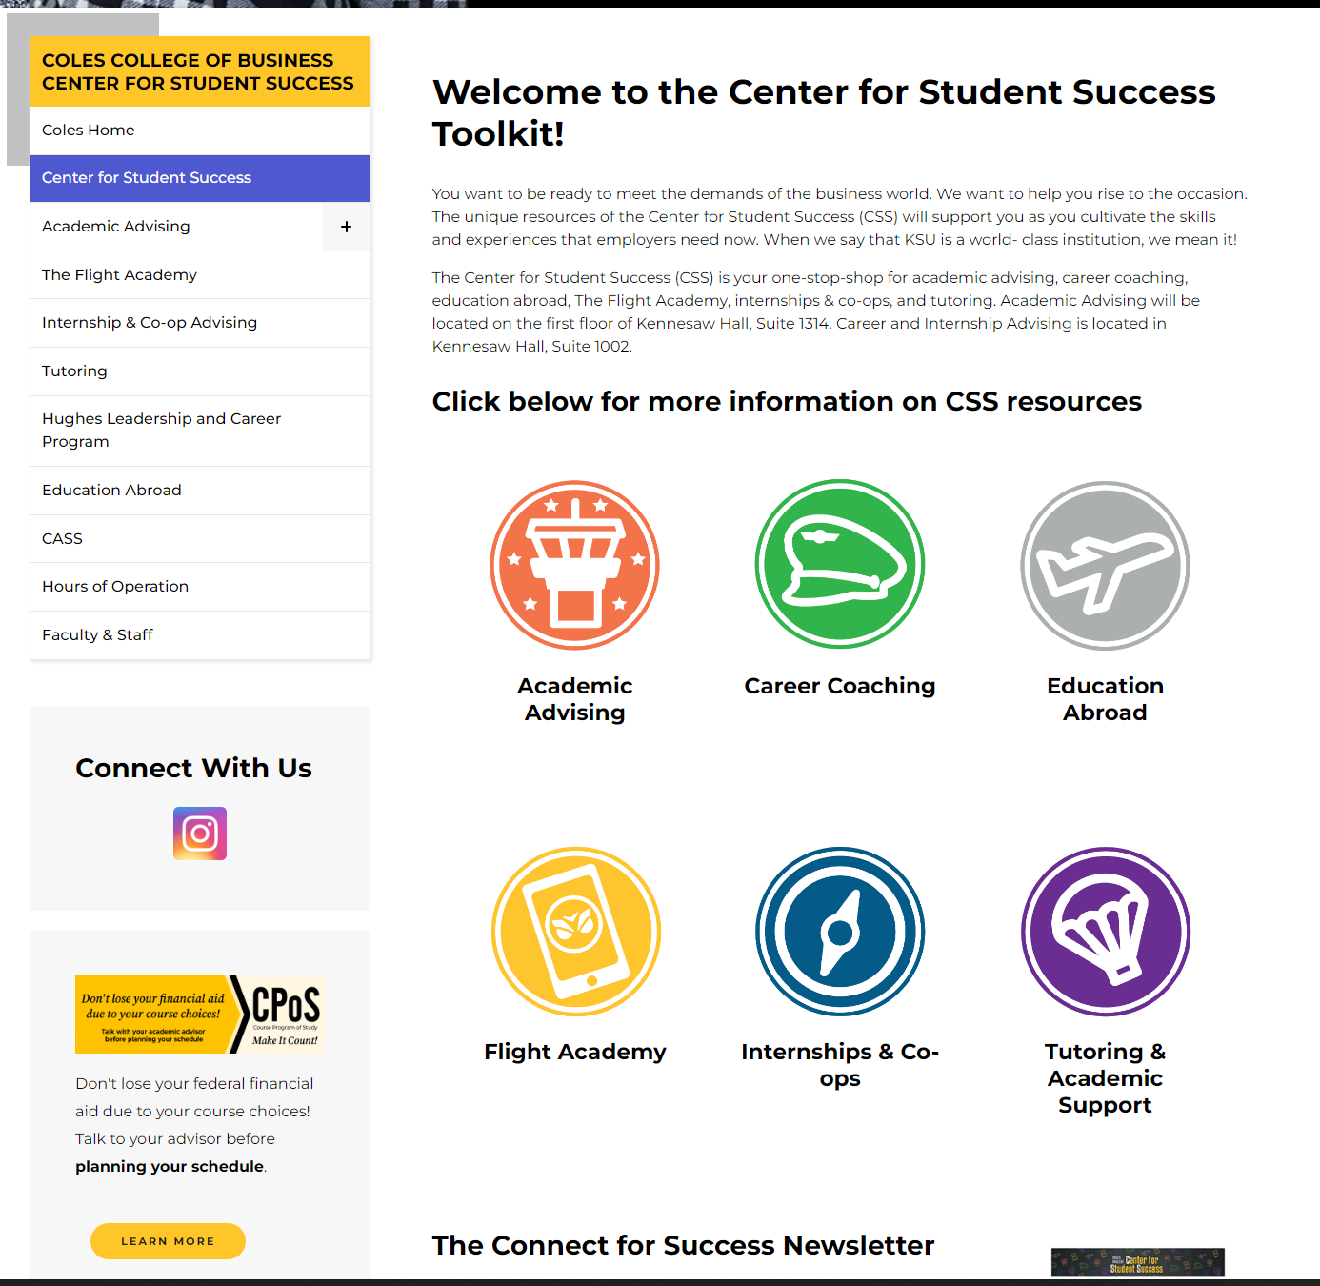
Recommendation of Website Setup

